Slide 1
ARD-Autonomous Response Drone
Team A1
Ali Baqar – alinbaqar@gmaill.com
Anahit Sarao - anahitsarao@gmail.com
Maxwell Cheshier - maxcheshier@gmail.com
Brian Josefowicz - brian.josefowicz@sjsu.edu
Notes:
Everyone

Slide 2
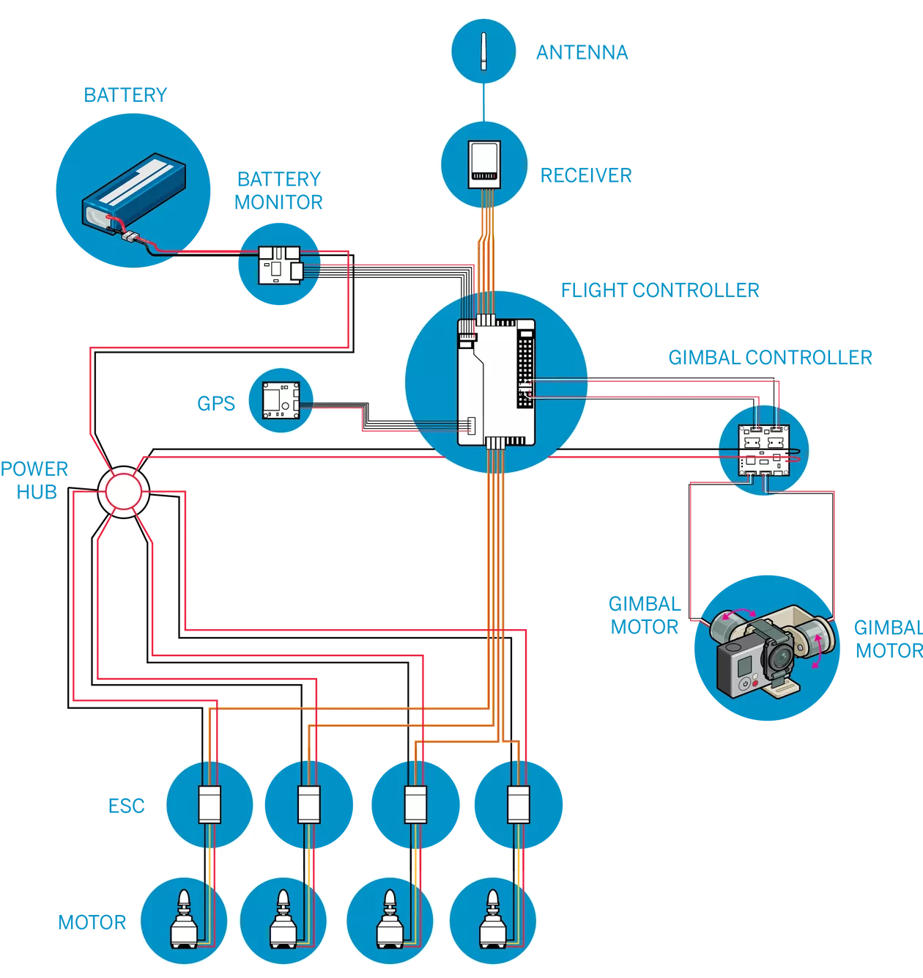
Design Overview
Proposed Hardware Design
Motors with ESC controller
Gimbal/Gyroscope
Antenna and Receiver
Battery
GPS / Magnetometer
IR/RF
Raspberry Pi daughter board
Notes:
Anahit

Slide 3
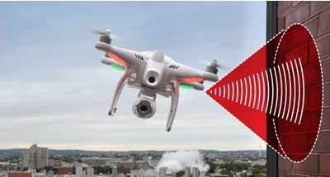
Challenges
Obstacle avoidance
Image capture
Autonomous flight accuracy
Drone laws and regulations
Signal reception
User locating
Notes:
-Max

Slide 4
Proposed Solutions
Infrared detection and flight optimization with gimbal
Increase field of view and pan
Utilize accurate coordinates and heading involving longitude, latitude, and true north
Careful analysis of drone laws and regulations and possible change of location
Apply for drone surveillance license
Determine the best emitter and receiver device or method for strong signal reception
Notes:
-Max

Slide 5
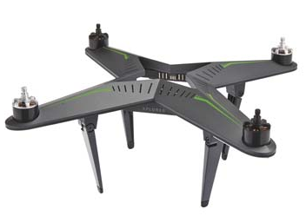
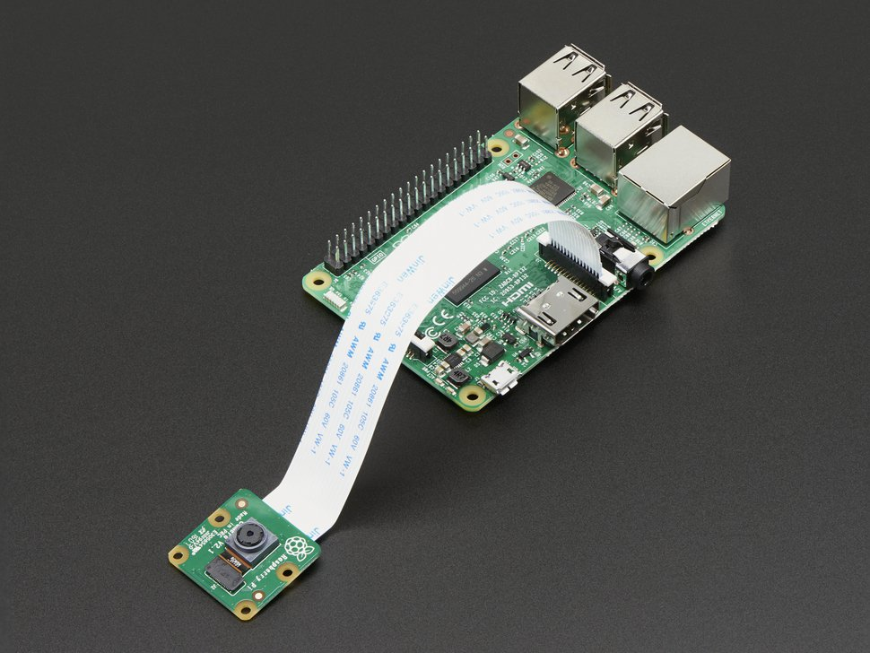
Detailed Implementation
Paparazzi UAV Software to control drone and communicate with appropriate sensors - Python
AeroQuad Software to control (Works with Raspberry PI and Arduino) - C, C++
XIRO drone Frame
AC Brushless Motor x4 (2 clockwise and 2 counter-clockwise)
4-channel Electronic Speed Control (ESC)
System Control Board
Radio transmitter and receiver
Propeller x 4 (2 clockwise and 2 counter-clockwise)
Battery & Charger
Gyroscope for flight stabilization
Gimbal for Camera control
Raspberry Pi Zero
Raspberry Pi Camera Board 8 megapixel
Notes:
Ali

Slide 6
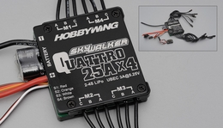
Current Status
Almost done with hardware specifications.
Some parts have been ordered. Still waiting to decide on certain peripherals and finalize bill of materials.
Software design stage will begin once hardware stage is finalized.
During the hardware development cycle the software architecture will be designed.
Notes:
Brian

